Slide 1
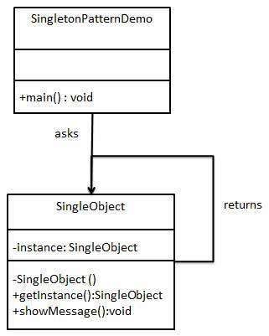
01. Singleton (creational)

Slide 2
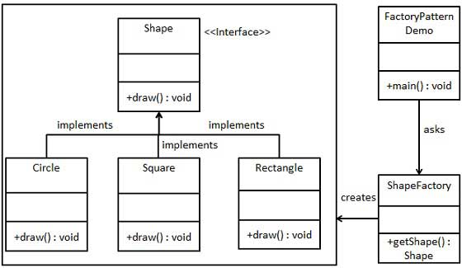
02. Factory (creational)

Slide 3
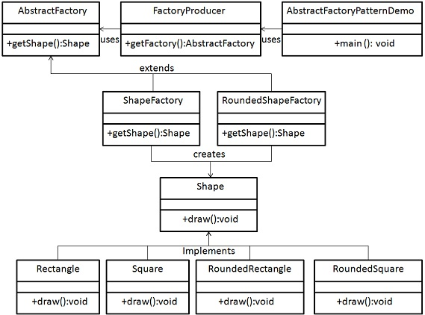
03. Abstract Factory (creational)

Slide 4
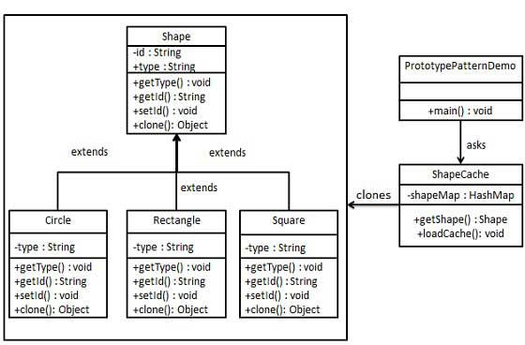
04. Prototype (creational)

Slide 5
5. Builder (creational)
Separate the construction of a complex object from its representation so that the same construction process can create different representations.
It is used to construct a complex object step by step and the final step will return the object
The process of constructing an object should be generic so that it can be used to create different representations of the same object

Slide 6
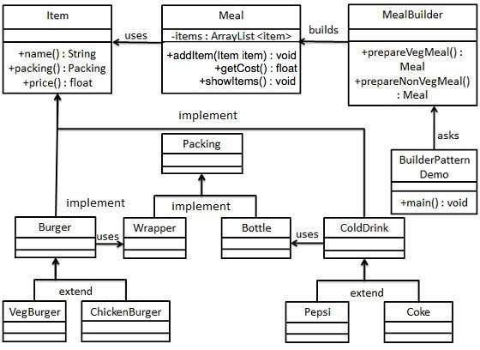
5. Builder (creational)

Slide 7
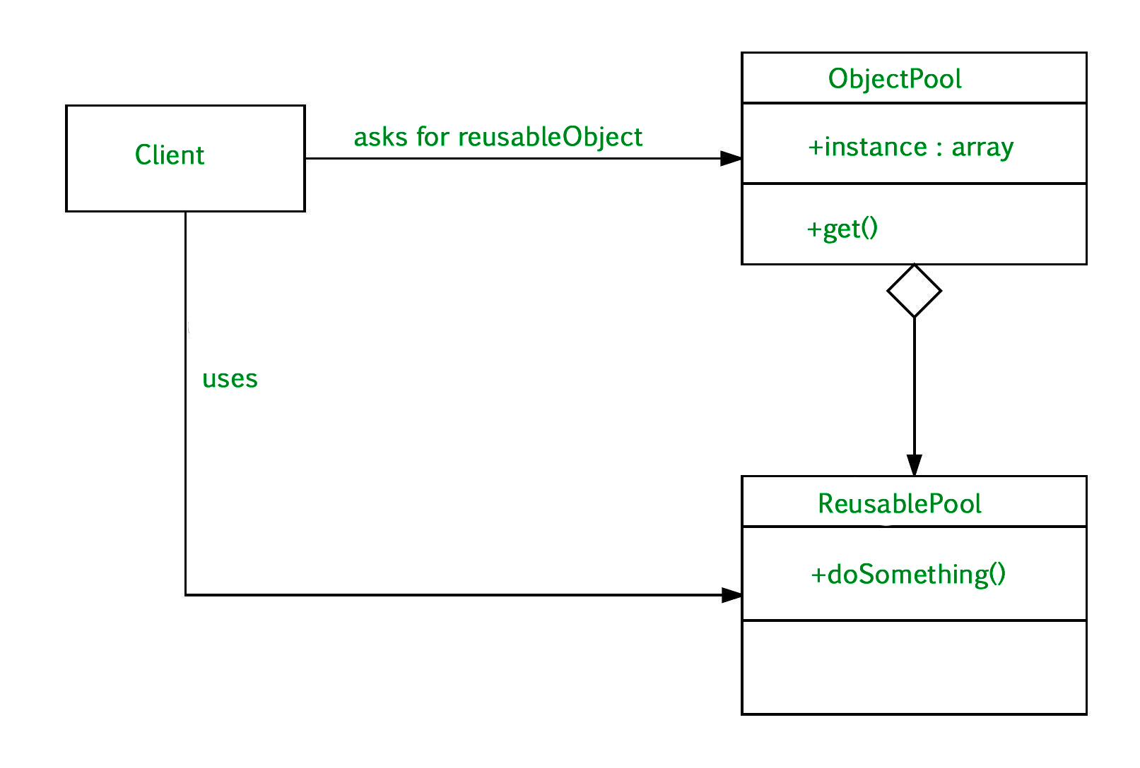
6. Object Pool (creational)

Slide 8
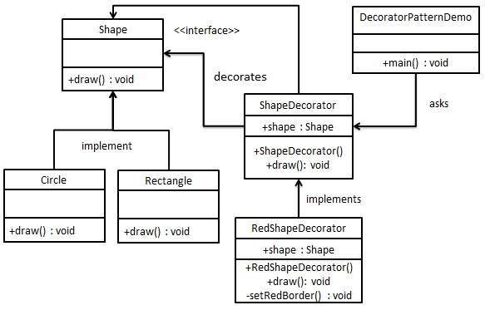
7. Decorator (structural)

Slide 9
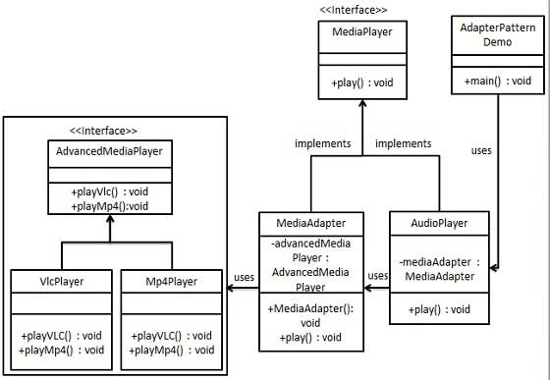
8. Adapter
(structural)

Slide 10
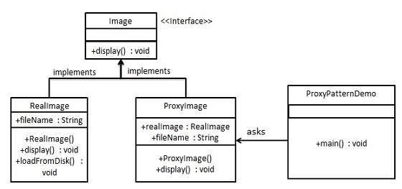
9. Proxy (structural)

Slide 11
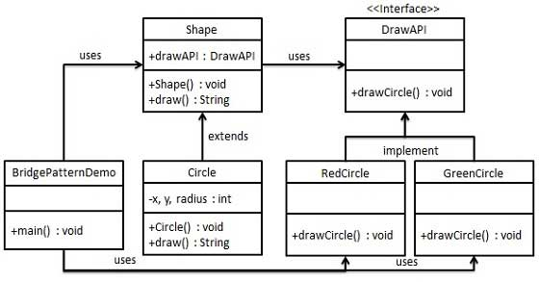
10. Bridge (structural)

Slide 12
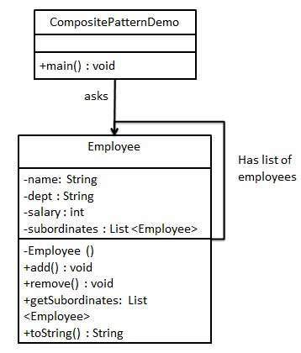
11. Composite (structural)

Slide 13
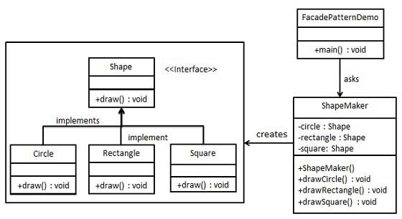
12. Facade (structural)

Slide 14
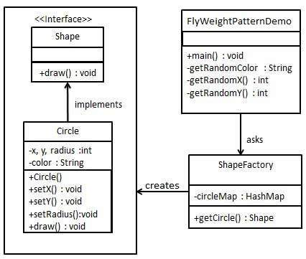
13. Flyweight (structural)
Flyweight pattern is primarily used
to reduce the number of objects
created and to decrease
memory footprint and
increase performance

Slide 15
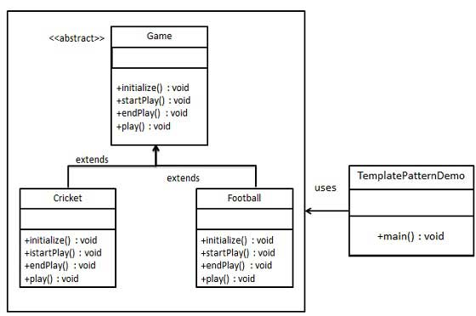
14. Template (behavioral)

Slide 16
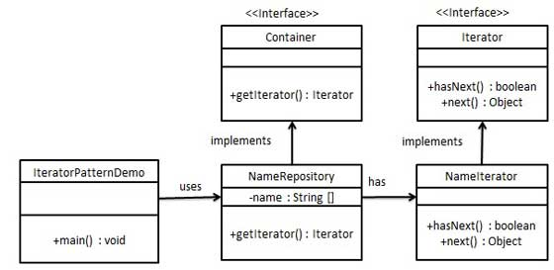
15. Iterator (behavioral)

Slide 17
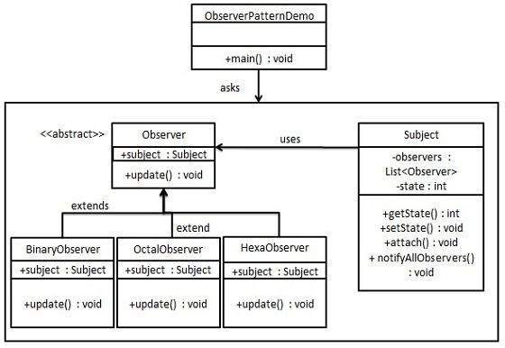
16. Observer (behavioral)

Slide 18
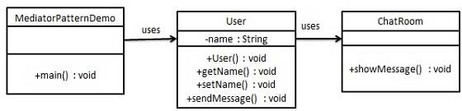
17. Mediator (behavioral)

Slide 19
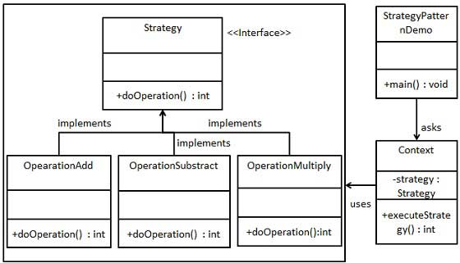
18. Strategy (behavioral)

Slide 20
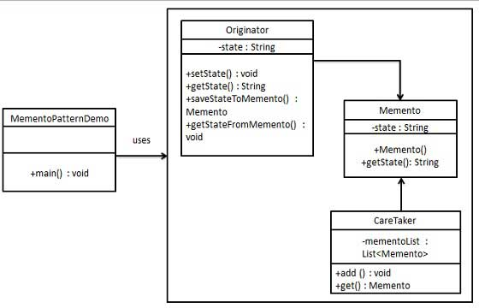
20. Memento (behavioral)
is used to restore
state of an object to a
previous state.
Memento contains
state of an object
to be restored

Slide 21
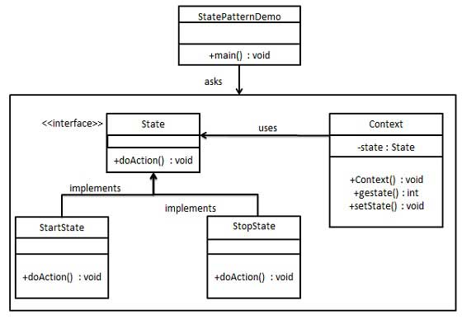
19. State (behavioral)
In State pattern a class
behavior changes based on
its state.

Slide 22
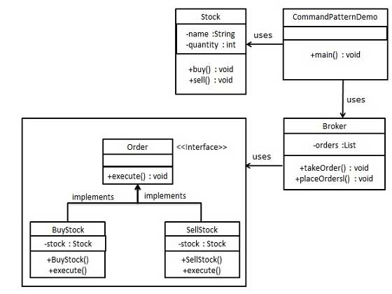
20. Command (behavioral)

Slide 23
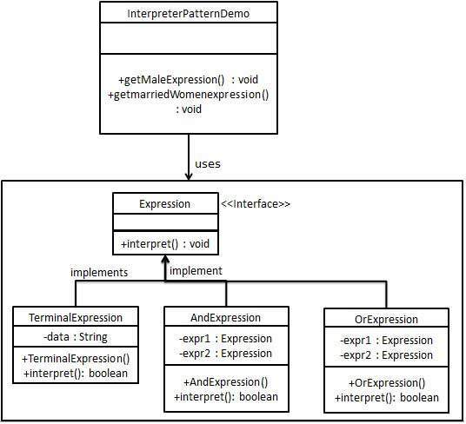
22. Interpreter (behavioral)
-Interpreter pattern provides a way to
evaluate language grammar or
expression
-This pattern involves implementing
an expression interface which
tells to interpret a particular context.
- This pattern is used in SQL parsing,
symbol processing engine etc

Slide 24
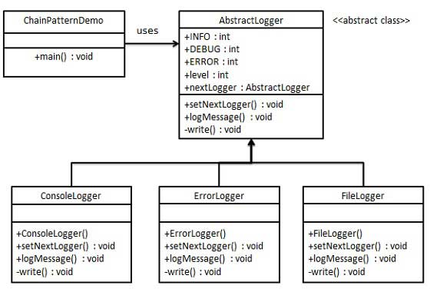
23. Chain Of Responsibilty
(behavioral)

Slide 25
24. DAO - Data Access Object
(structural)
Allows us to isolate the application/business layer
from the persistence layer.
The API hides from the application all the complexity of
performing CRUD operations in the underlying storage mechanism.
This permits both layers to evolve separately without knowing anything about each other.

Slide 26
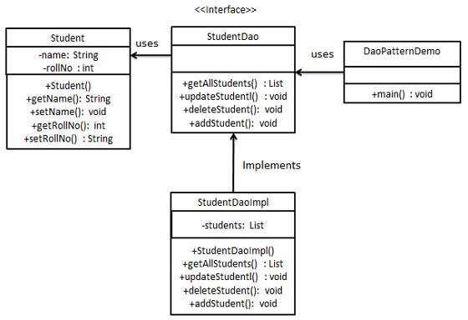
24. DAO - Data Access Object
(structural) contd…

Slide 27
24. MVC - Model View Controller
(structural)
This pattern is used to separate application's concerns.
Model - Model represents an object or JAVA POJO carrying data.
View - View represents the visualization of the data that model contains.
Controller - Controller acts on both model and view.
It controls the data flow into model object and updates the view whenever data changes.
It keeps view and model separate.

Slide 28
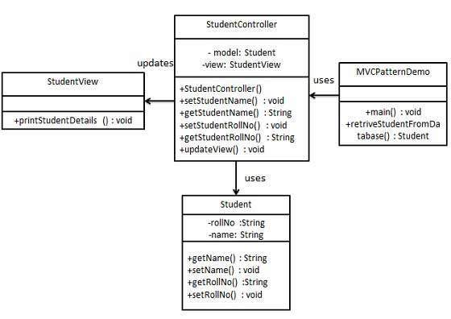
24. MVC - Model View Controller
(structural) contd…

Slide 29
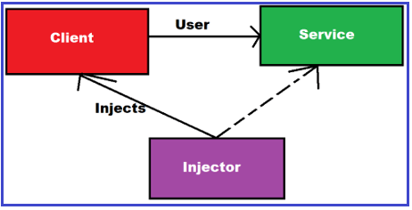
25. Dependency Injection

